Slide 1

Work-let Name: Multimodal AI-Driven Contextual Story Title Generation
Worklet Details
Worklet ID: 25SPF15
College Name: Vellore Institute Of Technology, Vellore
Technical Implementation KPIs:
Any Challenges/ Issues faced
100% preprocessing pipeline complete
Multimodal coverage achieved
Cross-attention model implemented
Training stabilized after data cleaning
Model predictions saved for post-processing
MSRVTT dataset contained low quality and noisy videos – this introduced noise in our clip embeddings and our ocr text as well.
The videos were multilinguistic due to which the ocr couldn’t recognize the text very well and also the asr couldn’t work well.
After many trial and errors on the initial architecture, we still faced many issues in the outputs due to the token stream and embeddings.
Key Achievements / Outcomes Till Now
Next Steps
MILESTONE 1 COMPLETED
MILESTONE 2 COMPLETED
Shifting the encoder from clip to siglip(google’s new vl encoder)
Milestone 3 – wrapping the architecture into an api
Date: 20/01/2026

Slide 2
Work-let Name: Multimodal AI-Driven Contextual Story Title Generation
Worklet Details
Worklet ID: 25SPF15
College Name: Vellore Institute Of Technology, Vellore
Resource Requirement Identified with Status
Github Repository Link and PRISM Portal Registration Status
System with Nvidia T4/A100/A4000 GPU
Atleast 64GB RAM
Fast Storage
https://github.ecodesamsung.com/SRIB-PRISM/VIT_25VI11VIT_Multimodal_AI-Driven_Contextual_Story_Title_Generation
Any Anticipated Break (Due to exams etc)
N.A
Data Collection Information
Data Collected from VIDEOSTORY46K dataset Dataset Link - https://ivi.fnwi.uva.nl/isis/mediamill/datasets/videostory.php
Date: 16/12/2025

Slide 3
Work-let Name: Multimodal AI-Driven Contextual Story Title Generation
Worklet Details
Worklet ID: 25SPF15
College Name: Vellore Institute Of Technology, Vellore
Professor Comments
Cross-attention fusion model implemented.Validation and training loss is reduced for 3 epochs. Futher epochs will be performed and analyze the output.
COMPUTATION RESOURCE Details:
With the development phase complete, we are now leveraging the on-campus Samsung Prism systems to scale up the preprocessing pipeline for the full dataset and commence model training.
Date: 16/12/2025

Slide 4
Dataset
Initial Dataset
Started with MSR-VTT (Microsoft) dataset
Observed major issues:
Noisy and low quality videos
Updated Dataset
Shifted to VideoStory48K-style dataset
Videos are clear and all of them are in English
Took out 350 videos from the dataset to verify the architecture and the model
Issues in videostory48k :
Ground truth isn’t grammatically correct – just contains random words which might relate to video
Solution – Wrote all the ground truth titles manually for all 350 videos

Slide 5
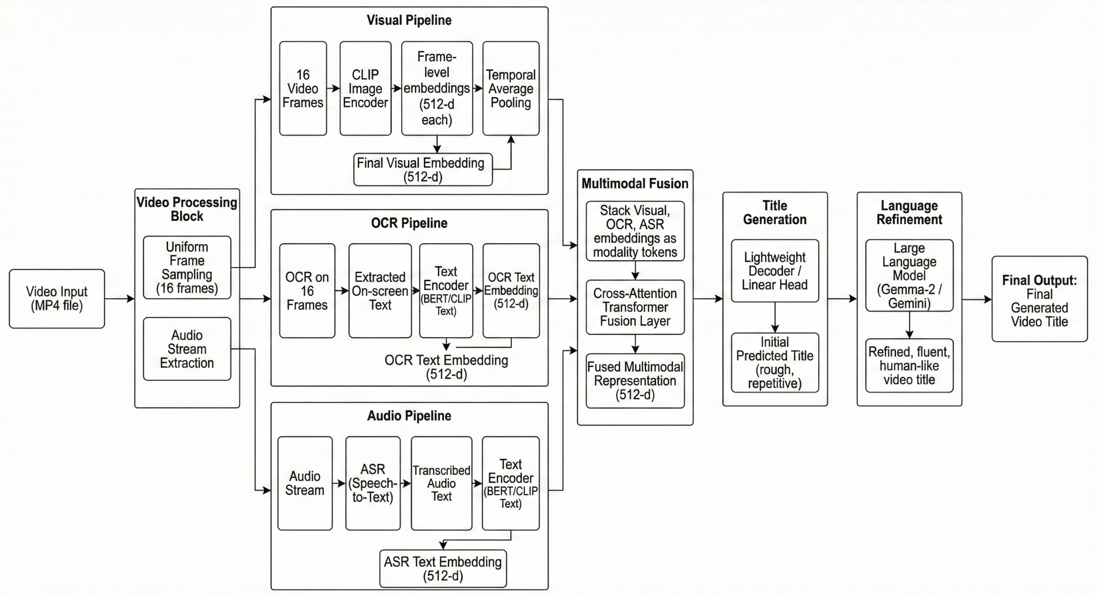
Architecture

Slide 6
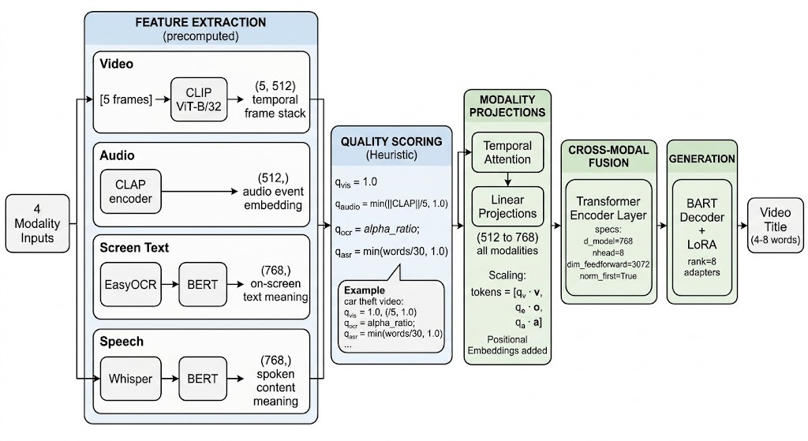
Updated Architecture

Slide 7
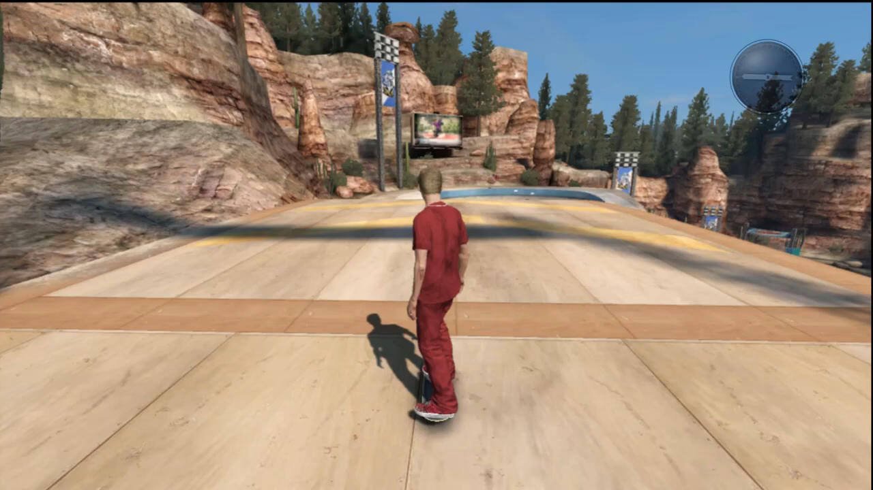
How it works…
Input Video

Slide 8
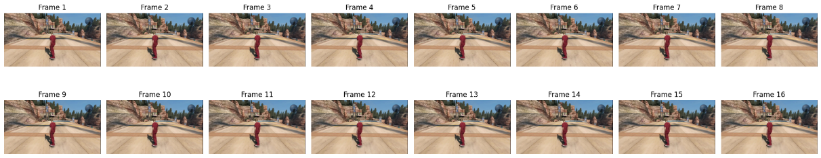
How it works…
OCR TEXT (EasyOCR) | AUDIO TRANSCRIPTION (Whisper - OpenAI) | Ground Truth Title( Written Manually ) | Title predicted after decoding with our transformer (Cross Attention Fusion) | Title Generated after served to gemma-2-2b
OLLIE BS 180 MELON 18 FRONTFLIP SWITCH x1.5 112 LINE: 112 MELON 180 FRONTFLIP 124 LINE: 124 | Hey guys, in this video today I'm going to be teaching you how to do a frontflip slash backflip on flat ground in skate 3 because what you want to do is when you're in the air you have to be in the air so not only you grab your board in the air and you do a frontflip or backflip. Um front flips are easier in my opinion, so try to go with front flip if you want like an easier tutorial, please Tell me and please subscribe. Thanks for watching guys. Peace | skating video game gameplay | skating | Skate 3 Front Flip Tutorial

Slide 9
OCR TEXT (EasyOCR) | AUDIO TRANSCRIPTION (Whisper - OpenAI) | Ground Truth Title( Written Manually ) | Title predicted after decoding with our transformer (Cross Attention Fusion) | Title Generated after served to gemma-2-2b
WAVE 3 NEWS SUNRISE CEDRA MAYFIELD DEADLY SHOOTING INVESTIGATION KATHY BROWN WHAT IF YOU COULD HELP SHAPE KENTUCKY'S FUTURE WITH JUST A FEW CLOCKS? TODAY YOU CAN! WAVE 3 NEWS PRESENTS KENTUCKY' GIVES DAY | Cedra Mayfield is tracking the story and said her investigators think this started as a case of a domestic situation. Yeah, Lauren and john right now, investigators are taking a look into every single tip that they get one of them a tip from neighbors that just moments before the shooting, yelling could be heard coming from that family's home. Now, this all started around 5 30 Tuesday evening is an argument between a father and a stepson. But that dispute quickly escalated from yelling to gunfire. We caught up with one neighbor who says she couldn't believe what she saw next. All of a sudden we heard this gunfire, so I walk outside the garage and when I look around I saw the stepson over his stepfather with a gun. The victim identified as 37-year-old Hugo Martinez, the shooter right now only being identified as Martinez' 17-year-old stepson. | shooting in lousiville in a family | shooting shooting shooting shooting shooting shooting shooting shooting shooting shooting shooting shooting | Deadly Shooting in Family Home

Slide 10
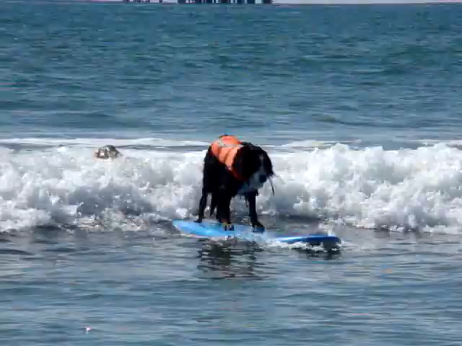
Input Video

Slide 11
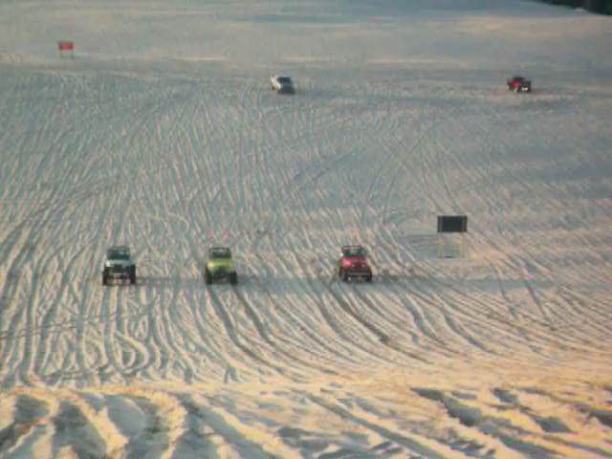
Input Video

Slide 12

Results for v3

Slide 13
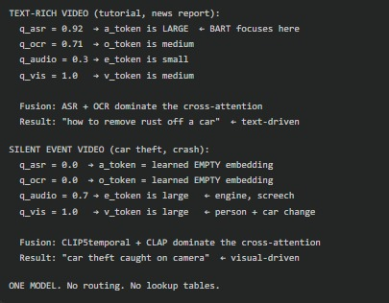
V4 - Parameter Budgeting

Slide 14
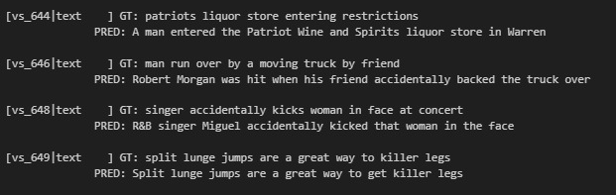
Results

Slide 15
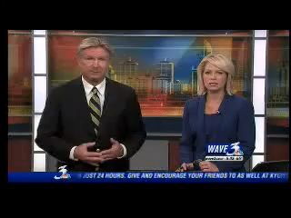
Example - 2

